Slide 1

Use Case Analysis
Notes:
‹#›

Slide 2
Use Case Process: Moving to Analysis
Use cases so far have been independent
Document each use case as a statement of need
But, we have not yet discussed how they relate to each other
Use case analysis: considers how use cases relate to each other
Begins to partition the problem space
A good suggestion is to use two use cases models
One after elicitation
The other at the start of analysis

Slide 3
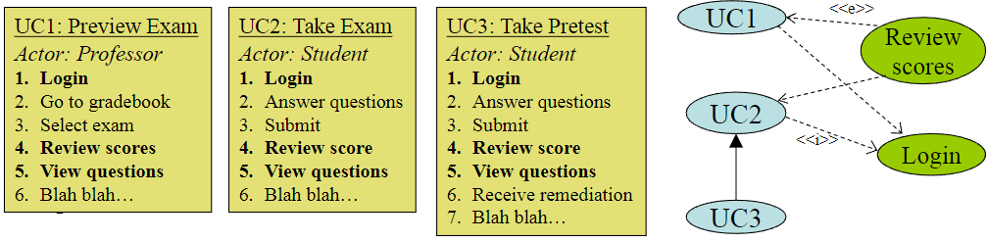
Use Case Process: Moving to Analysis
So where are we going with this?
Use cases have so far been developed independently
We need to start identifying how these cases overlap

Slide 4
Use Case Relationships
You may find that:
Some use cases share common subsets of behavior
Some use cases have several modes or special cases
Some use cases have multiple flows (extensions or variants) you would like the show in the use case diagram
Some actors are specializations of other actors
What do you do?
Identify and factor these behaviors into use cases that are related to one another
Create actor specializations and generalizations

Slide 5




Use Case Relationships
The purpose of use case relationships is to provide your system’s designers with some architectural guidance so they can efficiently break down the system’s concerns into manageable pieces.
- Learning UML 2.0

Slide 6
Use Case Analysis Notation
Notes:
‹#›

Slide 7
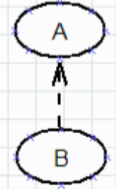
Notation: Use Case Relationships
Use Case Relationships show:
Dependency
Plus stereotypes like <<include>> and <<extend>>
Generalization
Dependency
General UML notation
This means that a change in the specification of one model element may imply a change in another element

Slide 8
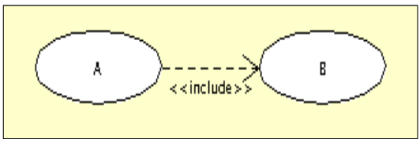
Notation: Use Case Relationships
<<include>>
This is a stereotype of a dependency
It means the behavior of B is included in A
The included use case is necessary to ensure the proper functionality of the base use case
Typically, there will be multiple use cases that include B
B does not require a primary actor, but it will require a triggering event
Example: Authentication processes must include fingerprint verification

Slide 9
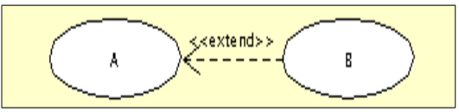
Notation: Use Case Relationships
<<extend>>
This is another stereotype of a dependency
It means the behavior of B may be incorporated into A
The extending use case is used to add specialized behavior to the base use case
The base use case defines where it can be extended through an extension point
<<extend>> is often confused with use case generalization
<<extend>> indicates an optional extension to a use case
So, it acts as a bit of a cross between <<include>> and generalization
Reusable specialization of a use case
Example: An authentication process after 5 PM may be logged in the security logbook

Slide 10
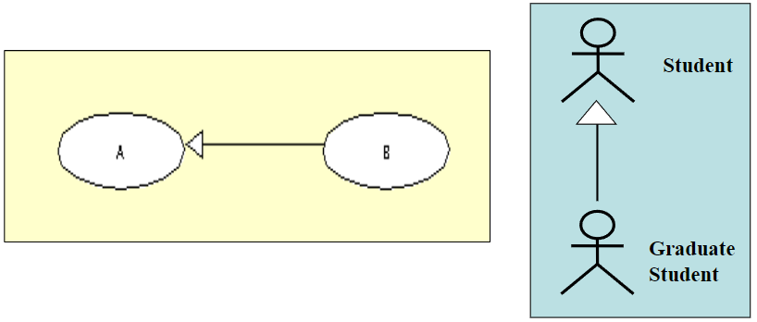
Notation: Use Case Relationships
Generalization
B inherits the behavior of A and is allowed to override and extend it
B inherits the communication relationships of A
Actors may apply Generalization as well
Example: A level 2 authentication process conforms to all constraints of a level 1 process but also requires a retinal scan

Slide 11
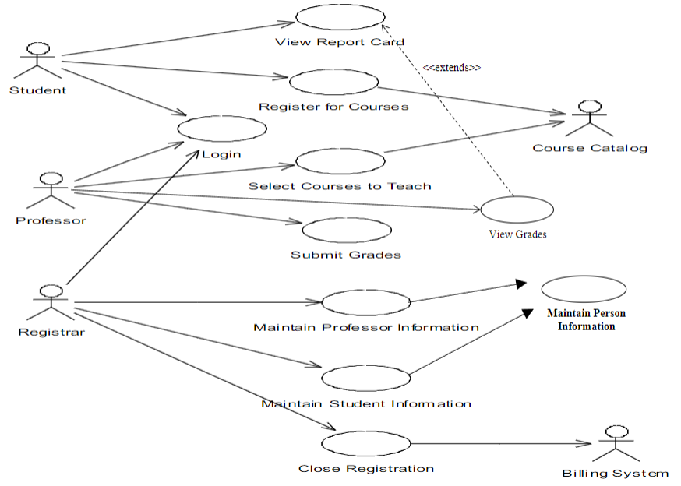
How Would You Read This Diagram?

Slide 12
Pro Tips
When do you use include, extend, or generalization?
For Actors:
A generalization is typically used to specialize a particular subtype (ie. A Graduate Student is-a Student)
Remember actors are stereotype classes, so it is possible to use Associations of any type
For example - a member of a group
For Use Case Relationships
<<include>> and <<extend>> are relationships between two distinct use cases (instance level, not type level)
Be careful of their direction - it is not a flow direction!
Generalization means one use case, which specializes the behavior of a given use case (type level, not instance level)

Slide 13
RUP-Centric Use Case Analysis
Notes:
‹#›

Slide 14
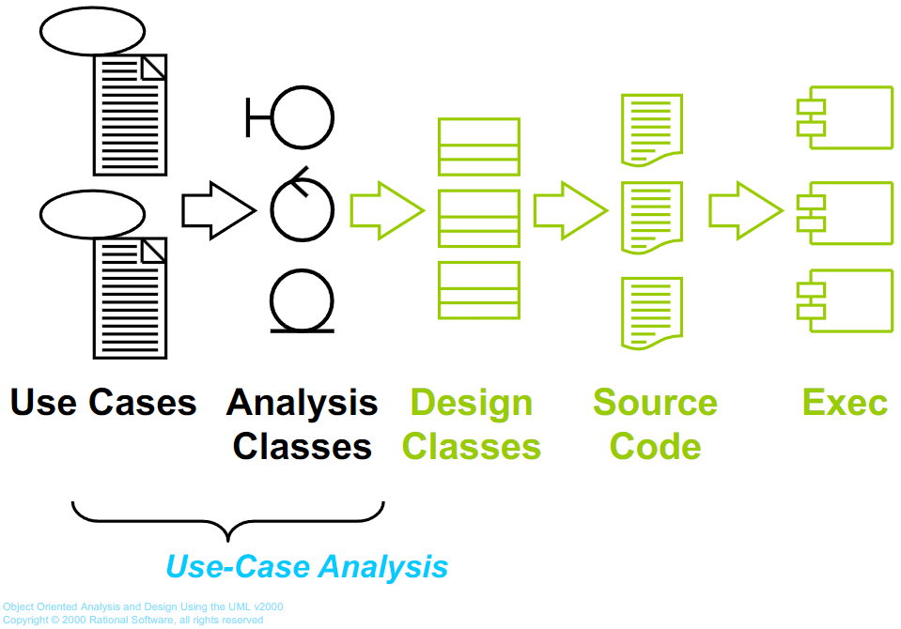
A First Step Towards Executables

Slide 15
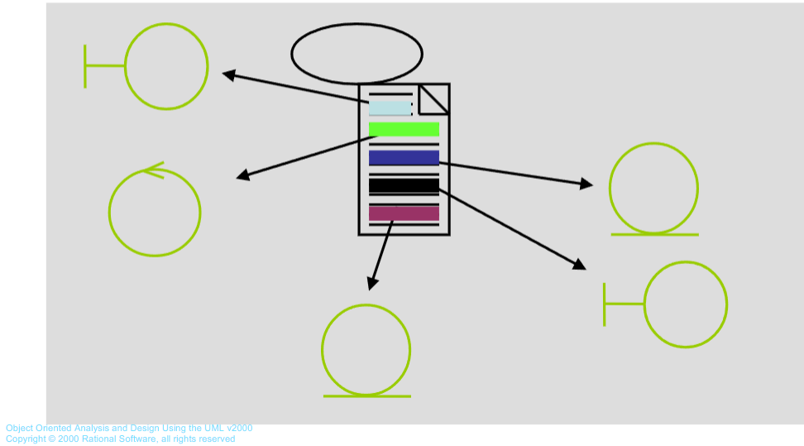
Find Classes From Use Case Behavior
The complete behavior of a use case has to be distributed to analysis classes

Slide 16
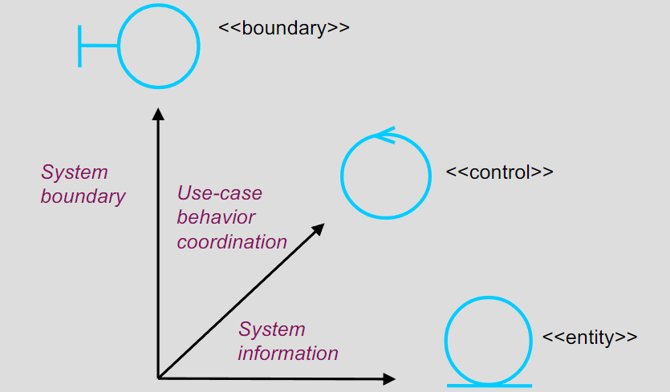

What is an Analysis Class?
Does not have to be one of the stereotypes
Focus on identifying responsibilities, not interface or method definitions

Slide 17
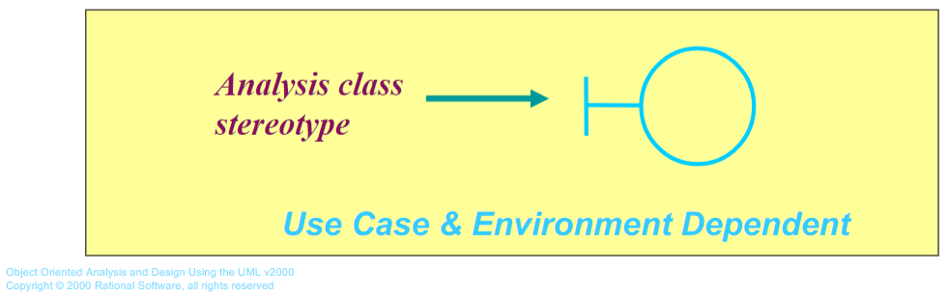
What is a Boundary Class?
Intermediates between the interface and something outside the system
Several Type such as:
User Interface classes
System interface classes
Device interface classes
One boundary class per actor - use case pair

Slide 18
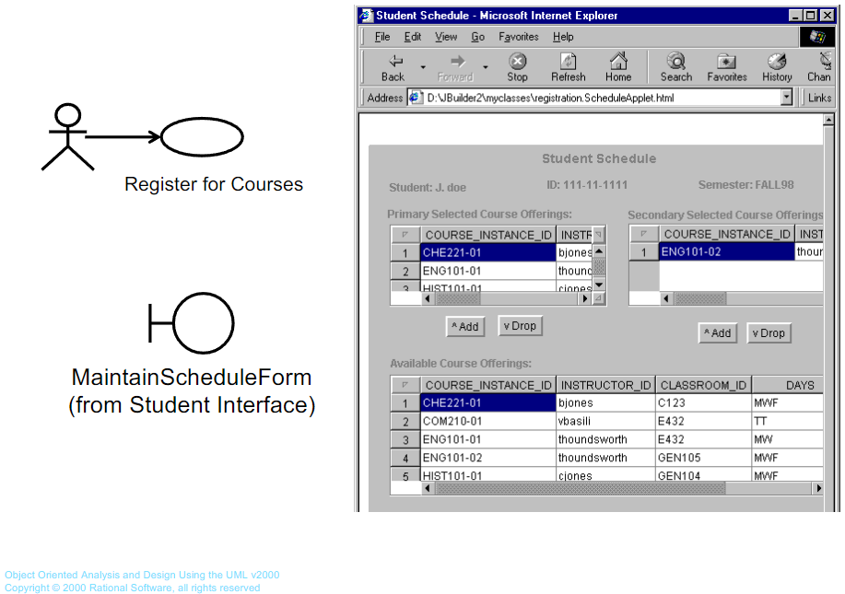
Example Boundary: UI Classes

Slide 19
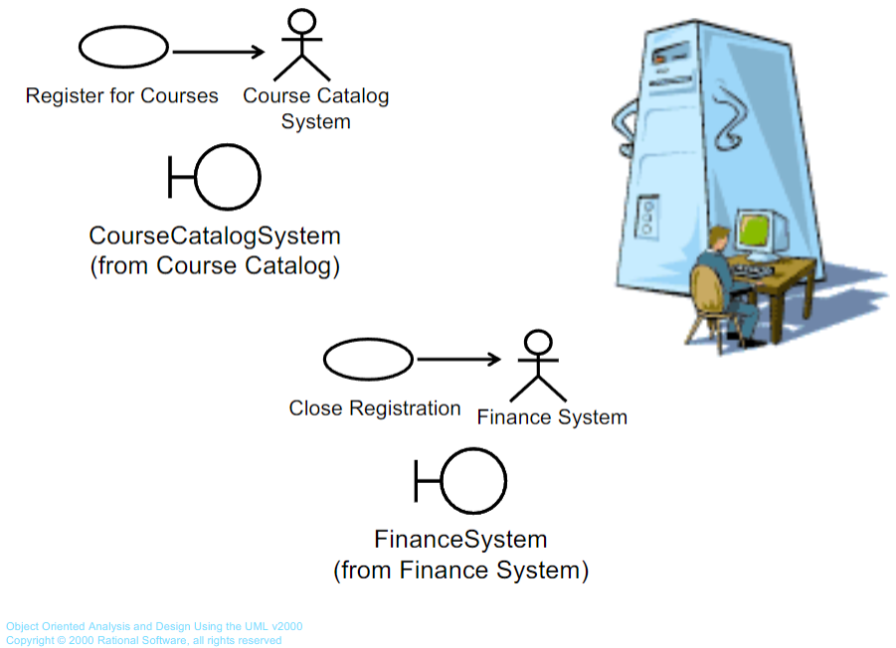
Example Boundary: System Interface

Slide 20
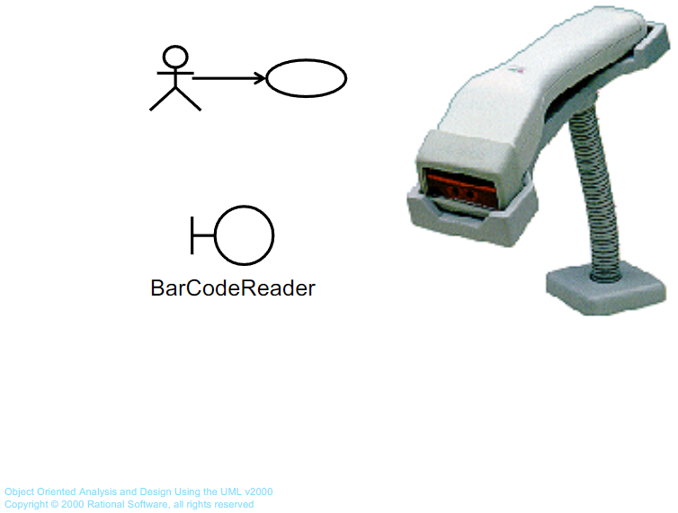
Example Boundary: Device Interface

Slide 21
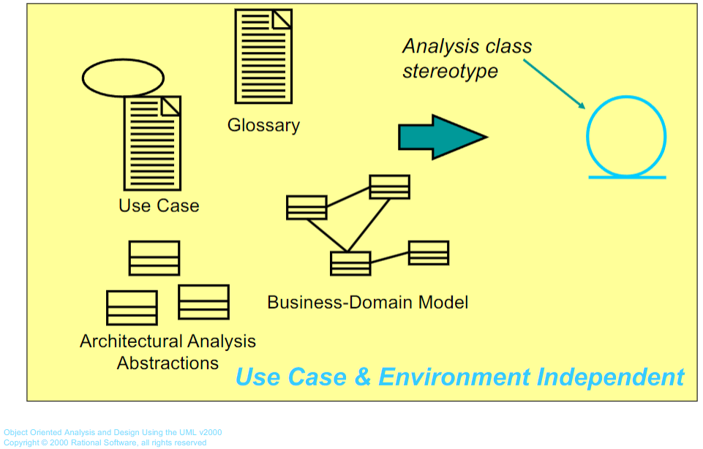
What is a Entity Class?
Key abstractions of the system

Slide 22
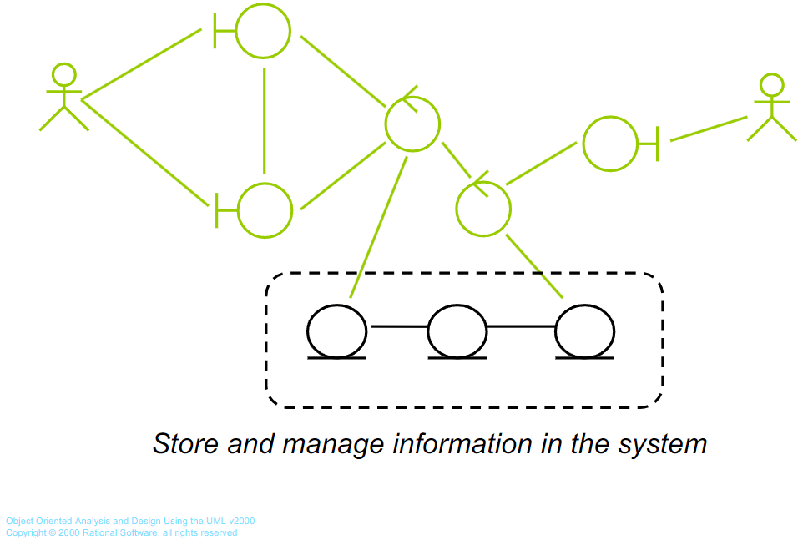
The Role of an Entity Class

Slide 23
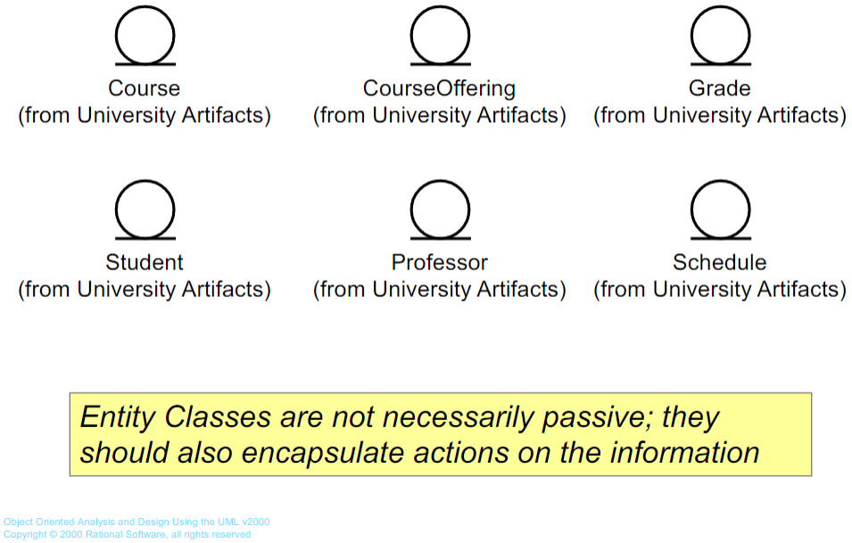
Example Entity Classes

Slide 24
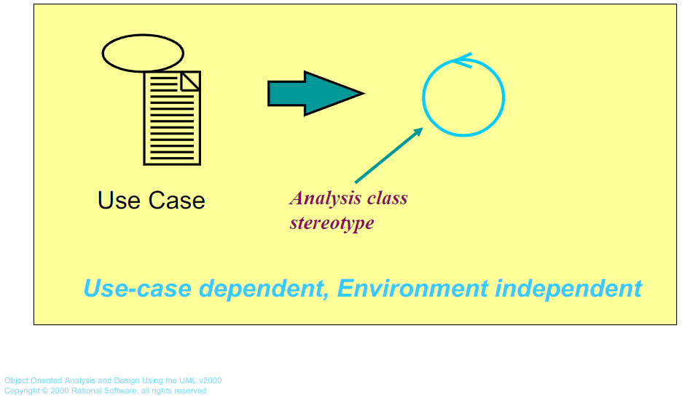
What is a Control Class?
Use case behavior coordinator
One control class per use case (to start!)

Slide 25
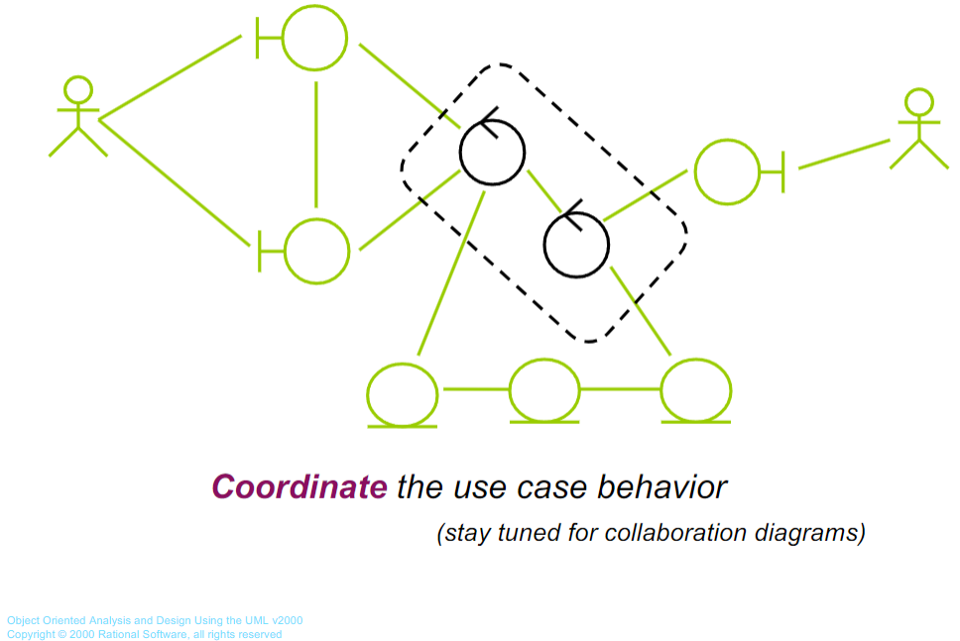
The Role of a Control Class

Slide 26
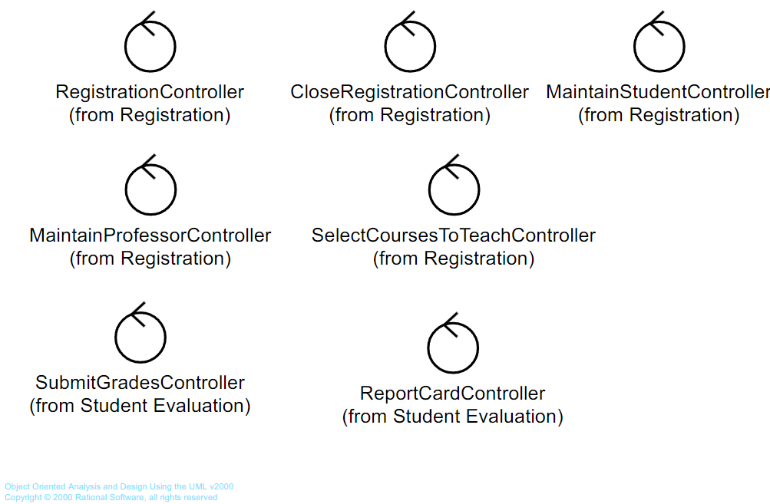
Example Control Classes

Slide 27
Use Case Analysis Guidelines
Notes:
‹#›

Slide 28
Use Case Modeling Process
Step 1: Identify Common Shared Behaviors
Perform a comprehensive review of your use case catalog and look for common subsets of behavior
If they’re useful, refactor these into new use cases related to other use cases (typically through <<include>>)
Step 2: Promote Visibility of Important Extensions
Behaviors that are complex or important in use case specification extensions should be made visible in the use case diagram (through <<extend>>)
Step 3: Consider Special Cases
Are these specializations of identified use cases?
Are they done by a specialized actor?
Step 4: Partition the Behaviors into Analysis Classes
Form natural patterns of behaviors that go together
You will recognize this pattern more when you start doing sequence diagrams
What common functionality will need to be implemented to satisfy behaviors?
Step 5: Start thinking about Architecture
Name high level components that can provide functionality
Keep this high level! It is only a “jumping off point” for doing analysis

Slide 29
Pros and Cons of Use Case Modeling
Pros:
Used to communicate with the end users and domain experts
Provides buy-in at an early stage of system development
Insures a mutual understanding of the requirements
Used to identify who interacts with the system and what the system should do
Used to verify all requirements have been captured and the development team understands the requirements
Used as the basis for the rest of the process lifecycle
For example - it can be used as the foundation for writing test scripts
Cons:
Captures only the functional requirements
Must complement with other techniques to get perspectives from all stakeholders
Organizing and identifying common functionality can be a “leap of faith”
Use case connections to the rest of RUP are a bit dodgy

